Slide 1


Paper Presentation
CSE 460 - VLSI Design
WILL YOU BE MY
Paper -A method to speed up VLSI hierarchical physical design in floorplanning.
PRESENTED BY -
Name - Ashakuzzaman Odree ; ID - 20301268
Name - Md Rakibul Islam ; ID - 20301373
Name - Priti Saha ; ID - 20101475

Slide 2

Abstract
Background :
Proposed Solution:
VLSI (Very-Large-Scale Integration) has seen rapid increases in size and complexity.
Meeting speed and quality in IC physical design is challenging.
Efficient model for swift VLSI floorplanning.
Utilizes Active-Logic Reduction Technology.
Replaces some modules in netlist file with filler units (no logical connections).

Slide 3
Abstract
Benefits:
Results from Experiments:
Reduces internal logical units.
Quickly predicts timing closure after top and block implementation.
Aids in quick quality assessment of the floorplan.
Maintains design quality while accelerating design flow.
Drastic runtime reduction: 6.2 times faster on average.
Memory usage reduction: 2.8 times less on average.

Slide 4
Introduction
IC Physical Design Process:
Importance of Floorplanning:
Gate-level netlist synthesis
Floorplanning
Power planning
Placement
Preroute (mainly trail route)
CTS (Clock Tree Synthesis)
Routing
Creation of GDSII layout file
Performance Optimization.
Power Efficiency
Thermal Management
Area Utilization
Cost Reduction
Routing Complexity
Area Utilization

Slide 5
Introduction
Challenges in Modern VLSI Design:
Historical Perspective:
Advanced manufacturing processes leading to increased chip integration and reduced size.
Emergence of Nano scale VLSI design makes EDA tools more crucial.
Complex netlists with tens of millions of gate-level units.
R. Otten introduced automatic floorplan design method in 1982.
EDA tools require multiple constraints for floorplanning due to its complexity.
Multiple iterations and adjustments needed to achieve desired physical design outcomes.

Slide 6
Introduction
Recent Innovations in Floorplanning:
Primary Concern:
Simulated annealing algorithm.
Guided incremental floorplan algorithm to reduce IR-drop violations using B*-tree representation.
P/G network and floorplan methods for quick design convergence.
Inefficiency in current methods due to repeated iterations and adjustments.
Need for advanced algorithms and model optimization to accelerate ASIC physical design without compromising on floorplan quality.

Slide 7

Quick floorplanning method
Hierarchical Design in VLSI
Active-Logic Reduction Technology (ART)
Simplified Model and Flex Filler: Quick Floorplanning

Slide 8
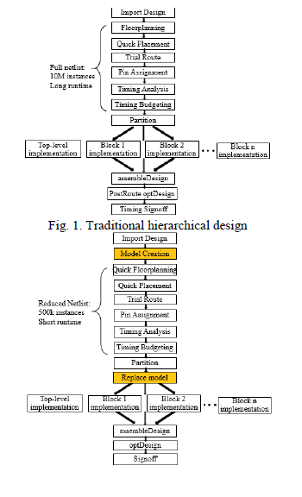
Hierarchical Design in VLSI
Introduction to the escalating complexity of VLSI design.
Highlight the proposed approach combining simplified modeling and hierarchical design.
Traditional process versus the proposed method's runtime comparison.
Emphasize the challenge of runtime in the traditional approach.
Introduce the concept of applying a simplified model to accelerate floor planning and the overall flow.

Slide 9
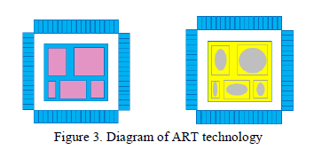
Active-Logic Reduction Technology (ART)
Explore Active-Logic Reduction Technology (ART).
Explain its foundation in Logical Reduction from computer science.
Showcase the significance of generating an active logical view.
Contrast the shortcomings of the traditional approach's timing prediction.
Describe how ART bridges the gap between partitioning and assembling stages.
Highlight ART's role in masking inactive logic units and boosting computation efficiency.

Slide 10
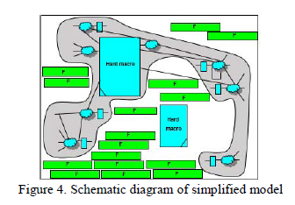
Simplified Model and Flex Filler
Delve into the concept of a simplified model for swift floorplanning.
Describe the use of logic minimization algorithms for design size reduction.
Detail the core of the method: a simplified model utilizing ART technology.
Introduce the flex filler as a solution for replacing irrelevant internal logic units.
Highlight flex filler advantages: larger area, absence of logical connections, reduced P&R runtime.
Emphasize that the simplified model preserves interface connections, enhances floorplanning, and maintains design quality.

Slide 11
Experimental Result and Analysis
Chip Size Reduction
Runtime Improvement
Congestion Analysis
Combined Benefits

Slide 12
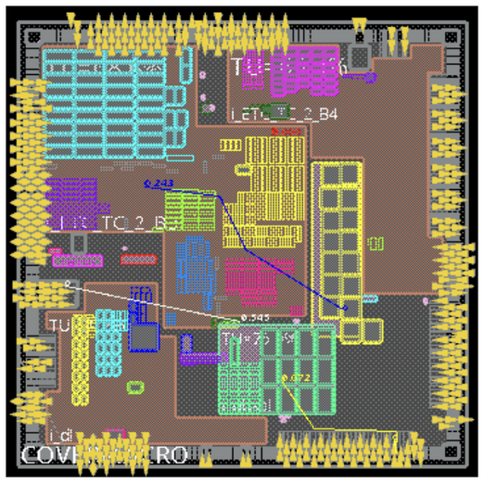
Chip Size Reduction
Original design size: 2.1M (2,086,769 instances)
After simplified model creation: 0.2M (128,695 instances + 71,829 inactive logics reduced)
Netlist size reduction: 9.6%
The simplified model effectively reduced the netlist size and improved subsequent design steps.
Fig: Chip design result of floorplanning with
simplified model

Slide 13

Runtime Improvement
Total runtime without simplified model: 807.95 minutes
Total runtime with simplified model partition: 145.08 minutes
Runtime reduction by 5.57 times (from 807.95 to 145.08 minutes)
Peak memory usage reduction by 2.22 times
The introduction of the simplified model significantly accelerated the design flow and reduced memory usage.

Slide 14
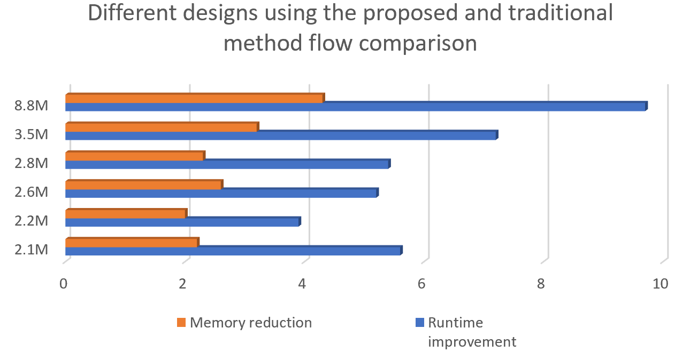
Compare

Slide 15
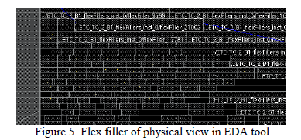
Congestion Analysis
Overall horizontal congestion: 0.10%
Vertical congestion: 0.35%
Congestion levels were within acceptable limits for a 2.1M design.
The method maintained reasonable congestion results while significantly accelerating the design process.

Slide 16

Benefits
Substantial reduction in design size, enhancing subsequent optimization.
The design flow runtime was improved, accompanied by reduced memory usage.
The method successfully achieved timing closure and maintained congestion within acceptable bounds

Slide 17
Conclusion
Floorplanning: determines the shapes and arrangement of sub-circuits or modules, as well as the locations of external ports and IP or macro-blocks power and ground routing
Shortening the floorplanning and evaluation runtime is an effective way to speed up chip's physical design.
This method can drastically reduce the runtime by 6.2 times and memory usage by 2.8 times

Slide 18
THANK YOU

